Slide 1
Education, Healthcare, and Military Spending of TOP 10 Nations
PRADIP HAYU
INDIVIDUAL PROJECT 1
DATS 6401 VISUALIZATION OF COMPLEX DATA
7 MARCH 2019

Slide 2
DATASET
DATA was obtained from two sources:
SIPRI Military Expenditure Database
World Bank Open Data
Years compared : 2009 - 2014
Data cleaning was done using Python and Excel
Top 10 nations in respective fields: education, healthcare, and military spending were selected
Google API, JavaScript, HTML will be used for visualization purposes

Slide 3
mission
Describe the educational, healthcare, and military spending of top 10 nations
Compare the spending data to that country’s GDP
Compare the education and health to the overall military spending of the country
Compare the per person educational spending to the per person GDP
Compare the per person healthcare spending to the per person GDP
Compare the per person military spending to the per person GDP
Figure out the fastest growing countries in healthcare and educational spending in fixed value and in percentage

Slide 4
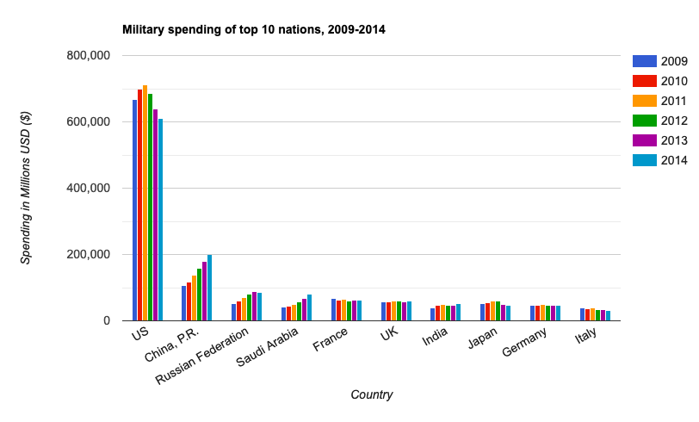
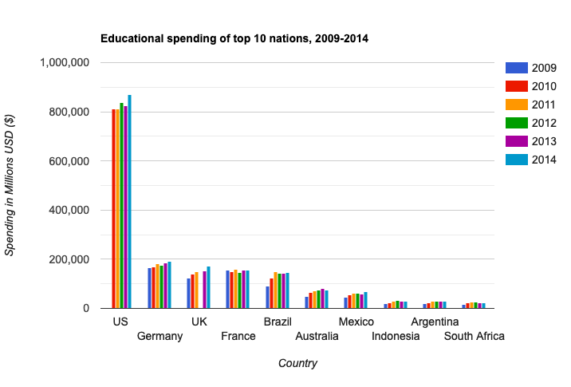
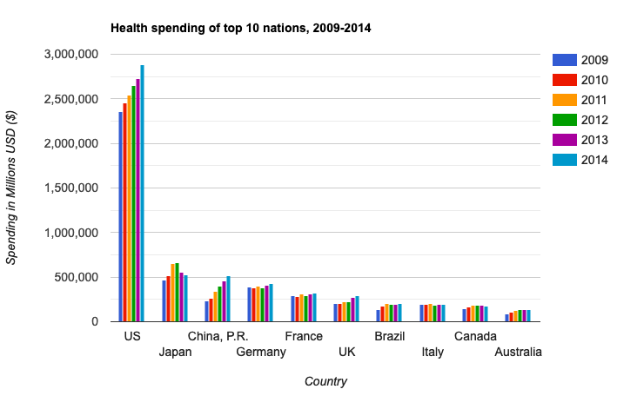
EDUCATIONAL, HEALTHCARE, AND MILITARY EXPENDITURE
Notes:
USA clearly spent the most in all three categories. Germany, Japan, and China came in second places for educational, health, and military spending respectively between 2009-2014.

Slide 5
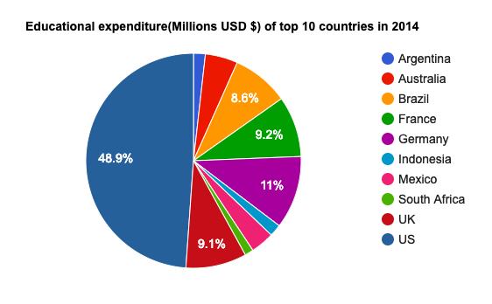
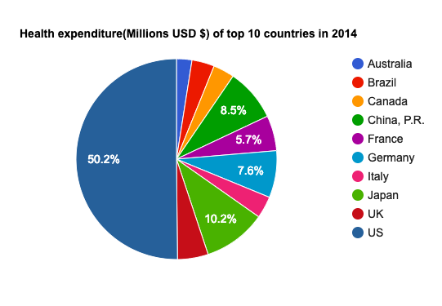
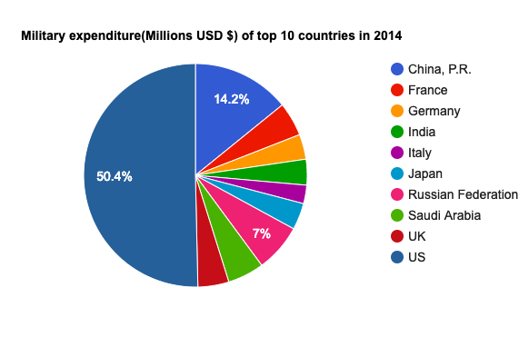
EDUCATIONAL, HEALTHCARE, AND MILITARY EXPENDITURE
Notes:
This 2014 representation of educational, healthcare, and military expenditure shows that USA spends the most in all three fields. USA’s expenditure was almost equal to the combined expenditures of the other 9 nations.

Slide 6
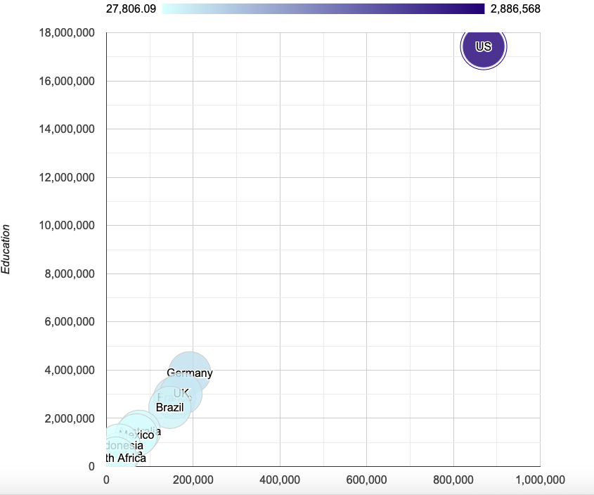
Education spending vs health spending vs gdp
Notes:
USA is an all rounder. It is way above in the spectrum when education spending, health spending, and GDP are compared together.

Slide 7
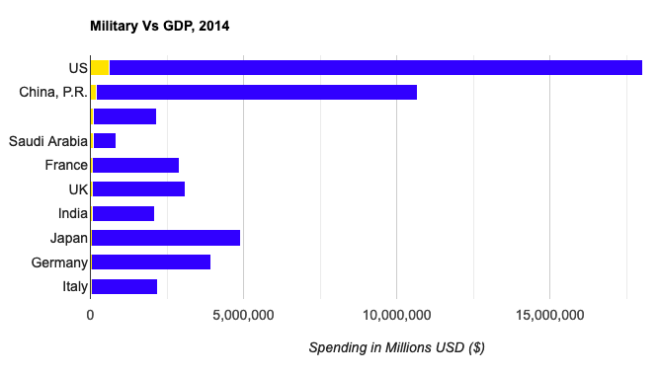
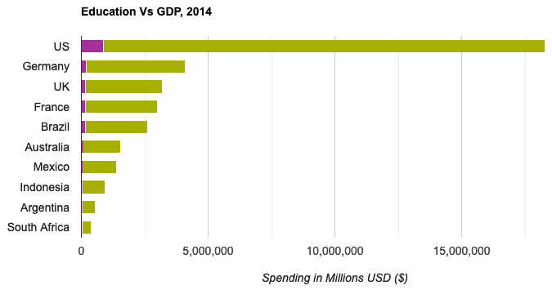
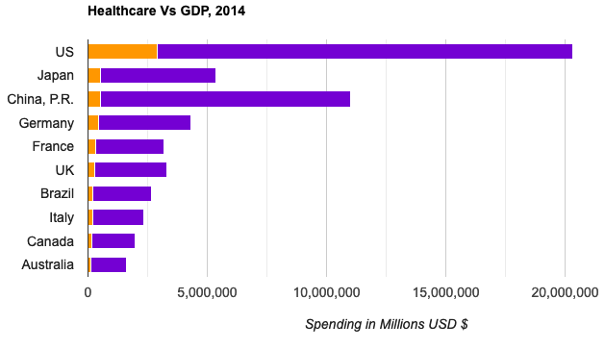
COMPARING WITH THE COUNTRY’S GDP
Notes:
In 2014, USA spent 16.5% of it’s GDP in healthcare, 4.98% of it’s GDP in education, and 3.49% of it’s GDP in military. Looking at the bar charts, the priorities of expenditures are: healthcare, education, and military respectively for majority of the countries. 50% of these top 10 countries spent less than 2% of their GDP in military expenditure.

Slide 8
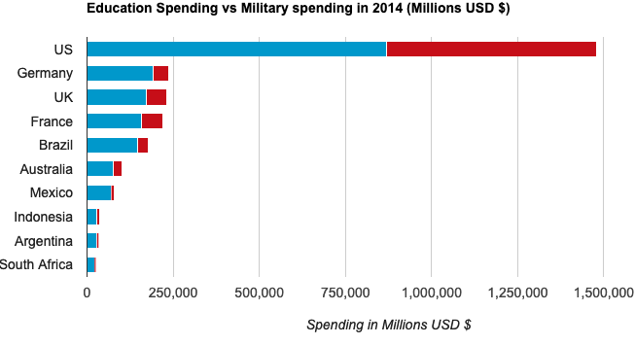
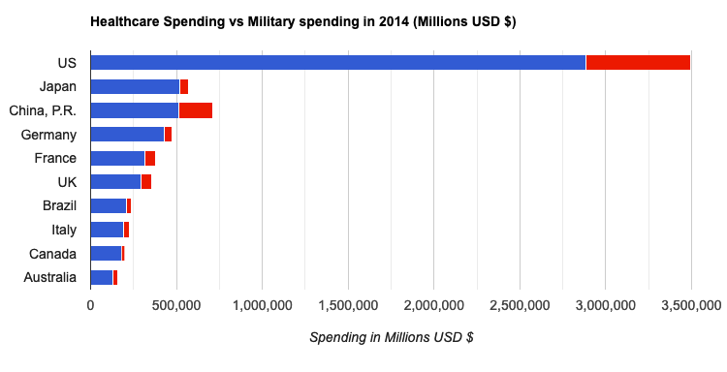
Comparing education and health to the overall military spending
Notes:
Looking at the bar charts, most of the countries spent more on education and healthcare compared than in the military.

Slide 9
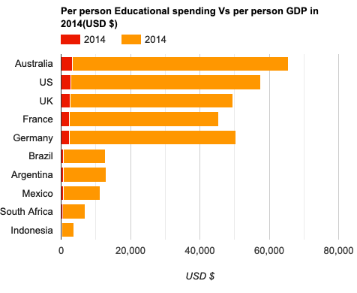
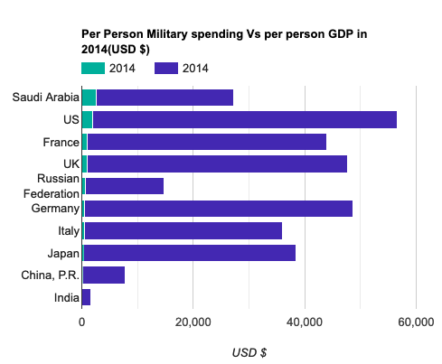
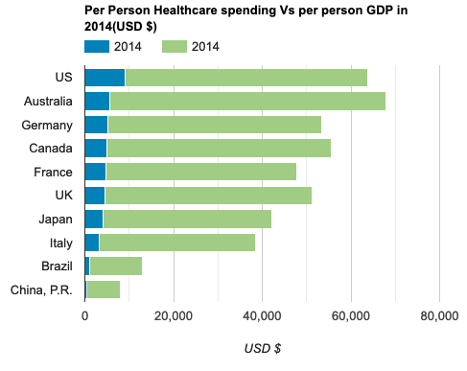
Comparing per person educational, health, and military spending to the per person gdp
Notes:
Among the countries compared, Australia has the highest per person GDP. Australia tops the list in per person GDP expenditure on education. USA claims the top spot on per person healthcare as a measure of per person GDP. Saudi Arabia spends most of it’s per person GDP in the military.

Slide 10
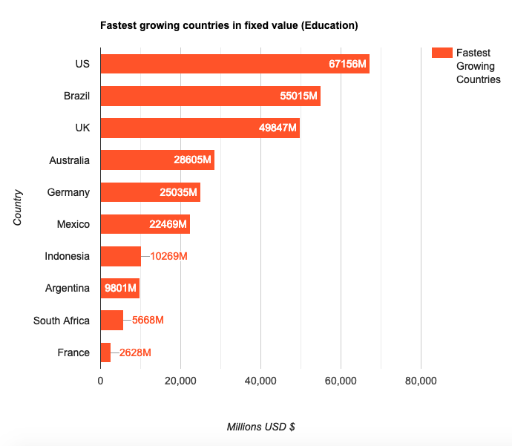
Fastest growing countries in education and healthcare
Notes:
USA is the fastest growing country in educational spending in fixed value followed by Brazil and UK.

Slide 11
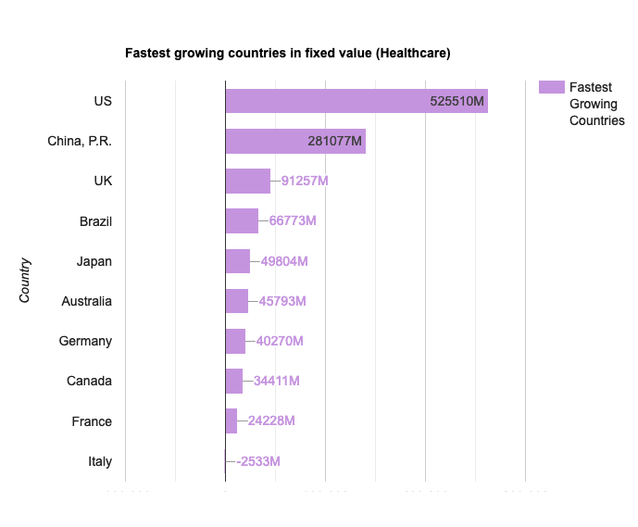
Fastest growing countries in education and healthcare
Notes:
USA is the fastest growing country in healthcare spending in fixed value followed by China and UK.

Slide 12
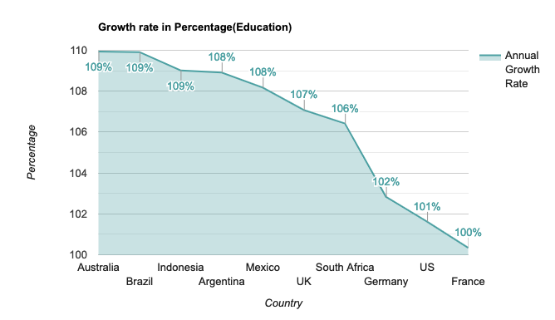
Fastest growing countries in education and healthcare
Notes:
Annual growth rate in education shows that Australia is the country with the highest growth rate, and France has the lowest growth rate in education.

Slide 13
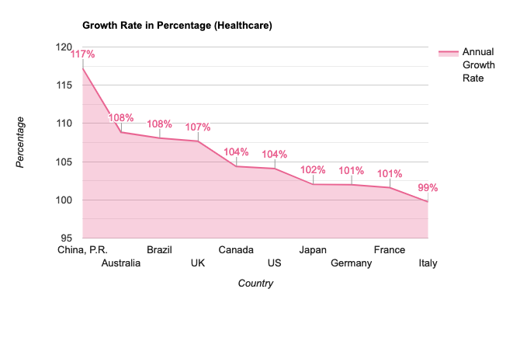
Fastest growing countries in education and healthcare
Notes:
China tops the list in terms of fastest growing country in healthcare spending in percentage.

Slide 14
CONCLUSION
USA clearly spends the most in all three categories(education, healthcare, military spending) for the years compared 2009-2014 along with the highest GDP.
In 2014, USA’s expenditure on all three categories was almost equal to the combined expenditures of the other 9 nations.
The priorities of expenditures are: healthcare, education, and military respectively for majority of the countries. 50% of these top 10 countries spent less than 2% of their GDP in military expenditure. Most of the countries spend more on education and healthcare compared than in the military.
Australia has the highest per person GDP. Australia tops the list in per person GDP expenditure on education. USA claims the top spot on per person healthcare as a measure of per person GDP. Saudi Arabia spends most of it’s per person GDP in the military.
USA is the fastest growing country in educational spending in fixed value followed by Brazil and UK.
USA is the fastest growing country in healthcare spending in fixed value followed by China and UK.
Annual growth rate in education shows that Australia is the country with the highest growth rate, and France has the lowest growth rate in education.
China tops the list in terms of fastest growing country in healthcare spending in percentage.

Slide 15
THANK YOU

